Slide 1



















climate
“From
crisis
TO
extinction
Crisis”
Team : Wildlife Whisperers
CLIMATE KNOWLEDGE HUNT HACKATHON
(2024)

Slide 2



What is actually happening?
IPCC_WGII-Chapter 2
1. Climate Impact:
Extinctions: Tropical regions (55%), freshwater habitats (74%).
Heat Waves: Local fish die-offs, mass mortality in birds and mammals.
Drought: Small ponds vanish, rare species affected.
2. Water Risks:
Streamflow: 42–79% of watersheds impacted.
Supply: Wildfires, deforestation, soil erosion.
3. Ecosystem Changes:
Altered precipitation patterns affect ecosystems.
Material transport impacted.
4. Species Vulnerability:
Vulnerable to 2.5°C warming.
5. Ecosystem Disruption:
Central/South America: Water flow disruption.
High-elevation wetlands degrade.
Question:
What are the factors having major roles in plant extinction?

Slide 3
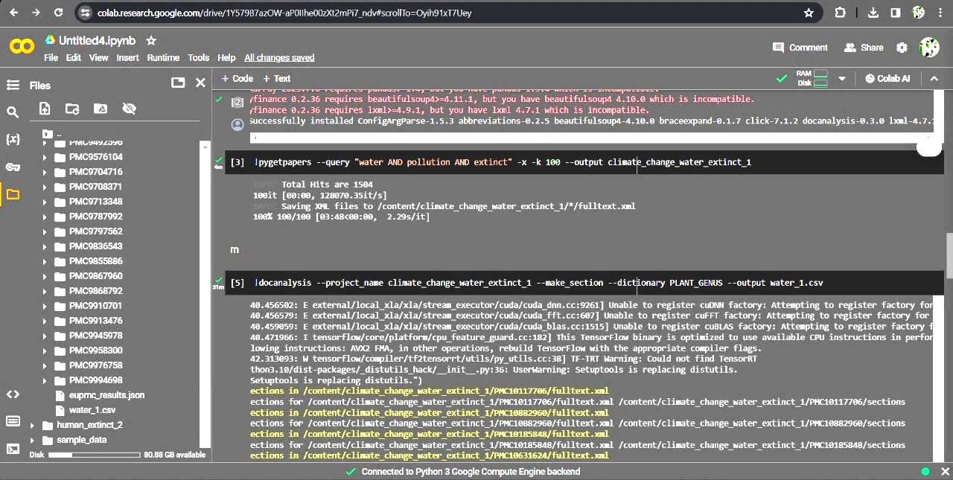
METHODOLOGY
Install package - pygetpapers
Install package - docanalysis
Choose “factors” – temperature
water pollution
air pollution
soil pollution
human activity
Select specific terms – extinct AND “factors”
Dictionary – PLANT_GENUS
Word cloud generation
Knowledge graph [Cytoscape]

Slide 4
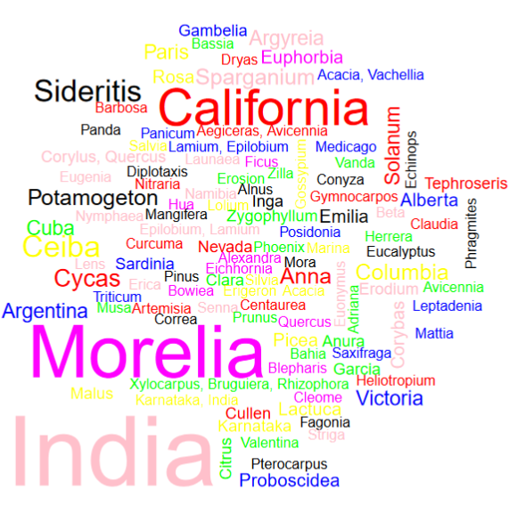
Word Cloud
Named entity recognition
Plot shows the occurrence of plants prone to extinction, along with their abundance in countries.

Slide 5
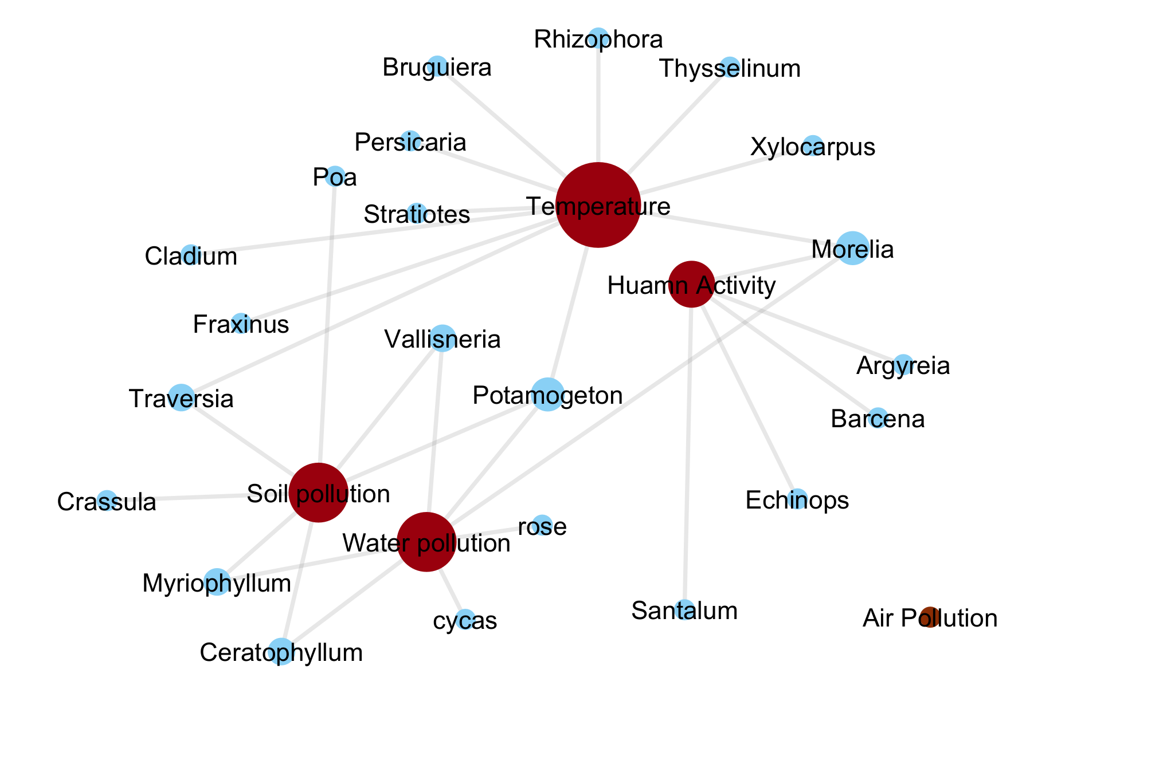
Knowledge Graph
We found no plant related to air pollution.
Highest number of species extinction because of temperature change, followed by soil pollution, water pollution and human activity.
Temperature change can be managed through reforestation, making green house etc.

Slide 6








THANK YOU !
Do you have any questions?
Pratibha Chaurasia
IGIB
Surabhi Seth
IGIB
Navya Gupta
M.Sc. biotech.
MRIIRS
Loveleen Kour
b.tech. biotech.
MRIIRS
Vanshika Verma
b.tech. biotech.
MRIIRS

